Slide 1
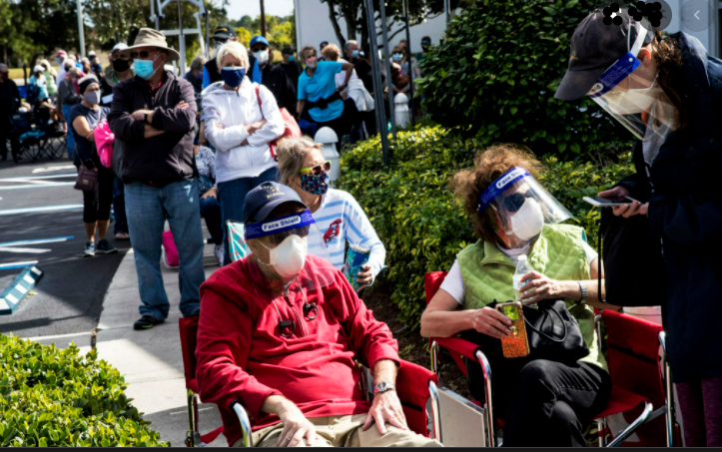

Slide 2
COVID-19 Vaccine PHFPC Debriefing
The information presented today is based on CDC’s recent guidance and MAY change.
Imelda Garcia, MPH
Associate Commissioner | Laboratory & Infectious Disease Services Division
April 13, 2022

Slide 3
COVID-19 Vaccination
The information presented today is based on CDC’s recent guidance and MAY change.
April 13, 2022

Slide 4
COVID-19 Vaccine Updates

Slide 5
COVID-19 Vaccine Updates Second Booster Dose
A second booster dose of the Pfizer or Moderna COVID-19 vaccine may be administered to individuals >50 years at least 4 months after receipt of a first booster dose of any authorized or approved COVID-19 vaccine.
A second booster dose of the Pfizer COVID-19 vaccine (>12 years) or Moderna COVID-19 vaccine (>18 years ) may be administered to certain immunocompromised individuals at least 4 months after receipt of a first booster dose of any authorized or approved COVID-19 vaccine.
In addition, adults who received a primary vaccine and booster dose of Johnson & Johnson’s Janssen COVID-19 vaccine at least 4 months ago may now receive a second booster dose using an mRNA COVID-19 vaccine

Slide 6
Terminology for COVID-19 Vaccine Dosing
Primary series:
For most people, a 2-dose series of an mRNA COVID-19 vaccine (Pfizer-BioNTech and Moderna) or a single dose of Janssen COVID-19 Vaccine.
For people who are moderately or severely immunocompromised, a 3-dose series of an mRNA COVID-19 vaccine or a single dose of Janssen COVID-19 Vaccine.
Additional dose: A subsequent dose of vaccine administered to people who were less likely to mount a protective immune response after initial vaccination. People who are moderately or severely immunocompromised and who received Janssen COVID-19 Vaccine for their primary series should receive an additional dose.
Booster dose: A subsequent dose of vaccine administered to enhance or restore protection which might have waned over time after primary series vaccination.
Homologous booster dose: The same vaccine product used for the booster dose was administered for the primary series.
Heterologous booster dose (mix-and-match booster): The vaccine product used for the booster dose differs from the product administered for the primary series.
Up to date: A person has received all recommended doses in their primary vaccine series, and a booster dose, when eligible. Receipt of a second booster dose is not necessary to be considered up to date at this time.
CDC Interim Clinical Considerations

Slide 7
COVID-19 Vaccines Approved or Authorized in the United States
Dose 1
March 29, 2022
March 29, 2022 | Age Indication | Vaccine Vial Cap Color | Dilution Required | Primary Series |  | Booster Dose ^{b}
 |  |  |  | Dose | Injection Volume | Dose | Injection Volume
Pfizer | 5 – 11 years | Orange | Yes | 10 mcg | 0.2 mLª | NA | NA
Pfizer | > 12 years | Purple | Yes | 30 mcg | 0.3 mL | 30 mcg | 0.3 mL
Pfizer | > 12 years | Gray | No | 30 mcg | 0.3 mL | 30 mcg | 0.3 mL
Moderna | > 18 years | Red^{d} | No | 100 mcg | 0.5 mL | 50 mcg | 0.25 mL
Moderna | > 18 years | Blue^{d} | No | NA | NA | 50 mcg | 0.5 mL
J&J’s Janssen^{c} | > 18 years | Blue | No | 5×10¹⁰ viral particles | 0.5 mL | 5×10¹⁰ viral particles | 0.5 mL
a: Dose based on age at the time of the vaccination
b: Booster doses may be mix and match for individuals >18 yrs, mRNA vaccines are preferred : Booster dose may be mix-and-match vaccine
c: mRNA COVID-19 vaccines are preferred over the J&J COVID-19 vaccine
d: Either Moderna COVID-19 Vaccine supplied in a vial with a red cap (0.25 mL injection volume) or Moderna COVID-19 Vaccine supplied in a vial with a blue cap (0.5 mL injection volume)
can be used to administer a 50 mcg booster dose.
CDC Interim Clinical Considerations

Slide 8
Moderna COVID-19 Vaccine Red Cap Vial HCP Fact Sheet
Moderna COVID-19 Vaccine Blue Cap Vial HCP Fact Sheet

Slide 9
COVID-19 Vaccines – Things We are Tracking
Advisory Committee on Immunization Practices (ACIP) meeting on April 20th, 2022
Booster dose for 5-11 years
Pediatric (6 months – up)
Moderna (6 months – 5 years) has begun rolling submission of data to the Food and Drug Administration (FDA)
Pfizer data with the 3-dose series at the end of this month with the anticipated filing with the FDA early June
A seasonal COVID-19 vaccine
Anticipate another FDA’s advisory committee meeting May/early June to discuss the specifics of a seasonal vaccine

Slide 10
Health Resources & Services Administration (HRSA) COVID-19 Uninsured Program

Slide 11
HRSA COVID-19 Uninsured Program
Due to the lack of supplemental funding from Congress, the Health Resources & Services Administration (HRSA) will stop accepting claims for reimbursement of costs associated with administering COVID-19 vaccines to uninsured and underinsured individuals as of April 5, 2022.
For more information, visit the HRSA’s webpage.
The Centers for Disease Control and Prevention (CDC) strongly encourages providers to stay in the CDC COVID-19 Vaccination Program, and CDC expects participating providers will continue to administer these lifesaving vaccines at no cost to patients to ensure equitable access for all individuals.

Slide 12
COVID-19 Vaccine Texas Overall Summary

Slide 13
 | Population Estimates | People Vaccinated | Fully Vaccinated | Up-to-Date
Texas Total | 28,995,881 | 20,659,709 | 17,440,027 | 8,282,458
 |  | 71% | 60% | 29%
5-11 years | 2,898,962 | 988,202 | 681,869 | 681,990
 |  | 34% | 24% | 24%
> 5 years | 26,967,586 | 20,654,264 | 17,438,642 | 8,282,127
 |  | 77% | 65% | 31%
> 12 years | 24,068,624 | 19,666,062 | 16,756,773 | 7,600,137
 |  | 82% | 70% | 32%
> 18 years | 21,596,071 | 17,856,952 | 15,313,944 | 7,181,541
 |  | 83% | 71% | 33%
> 65 years | 3,734,229 | 3,553,323 | 3,155,645 | 2,086,038
 |  | 95% | 85% | 56%
People Vaccinated includes first doses of Moderna and Pfizer and single doses of Janssen.
Fully Vaccinated includes second doses of Moderna and Pfizer and single doses of Janssen.
Up-to-Date includes people with an additional/booster dose and people who are fully vaccinated but not yet eligible for an additional/booster
Data as of 4/1/2022

Slide 14
Data as of 4/1/2022

Slide 15
Fully Vaccinated includes first doses of mRNA and single doses of Janssen.
Additional dose is any dose after primary series completion if dose administered is after 8/13/21. Percentage additional/booster is out of the total fully vaccinated
Data as of 4/6/2022

Slide 16
Individuals >50 yrs Eligible for 2nd Booster By Month (All Vaccines)
8,710,162
TX >50 yrs total pop
7,061,791
(81%)
People >50 yrs fully vaccinated¹
3,681,362
(45% total pop)
People >50 yrs received first booster dose² and eligible for a Second booster by July 22
Individuals>50 yrs Eligible for 2nd Booster By Month (All Vaccines) ³ | Total
22-Apr | 3,081,409
22-May | 410,329
22-Jun | 118,731
22-Jul | 70,893
1. Fully Vaccinated includes second doses of Moderna and Pfizer and single doses of Janssen.
First Booster doses includes all additional/booster doses administered on or after 8/13/21.
Second booster dose projected for 4 months post first booster dose by month.
Data as of 4/1/2022

Slide 17
Texas
Race/Ethnicity | 5-17 Population | 5-17 People Vaccinated | 5-17 Unvaccinated | % of the Sub-population Vaccinated | % of the Sub-population Unvaccinated
Asian | 236,847 | 134,999 | 101,848 | 57% | 43%
Black | 627,373 | 161,044 | 466,329 | 26% | 74%
Hispanic | 2,629,064 | 1,423,037 | 1,206,027 | 54% | 46%
White | 1,689,768 | 460,240 | 1,229,528 | 27% | 73%
Other | 179,685 | 536,907 | -- | -- | --
Unknown |  | 81,085 | -- | -- | --
Total | 5,362,737 | 2,797,312 | 2,565,425 | 52% | 48%
Race/Ethnicity | 18+ Population | 18+ People Vaccinated | 18+ Unvaccinated | % of the Sub-population Vaccinated | % of the Sub-population Unvaccinated
Asian | 1,112,883 | 927,483 | 185,400 | 83% | 17%
Black | 2,574,619 | 1,414,575 | 1,160,044 | 55% | 45%
Hispanic | 7,817,214 | 5,908,937 | 1,908,277 | 76% | 24%
White | 9,742,642 | 5,813,263 | 3,929,379 | 60% | 40%
Other | 384,756 | 2,953,669 | -- | -- | --
Unknown |  | 839,025 | -- | -- | --
Total | 21,632,114 | 17,856,952 | 3,775,162 | 83% | 17%
Data as of 4/1/22

Slide 18
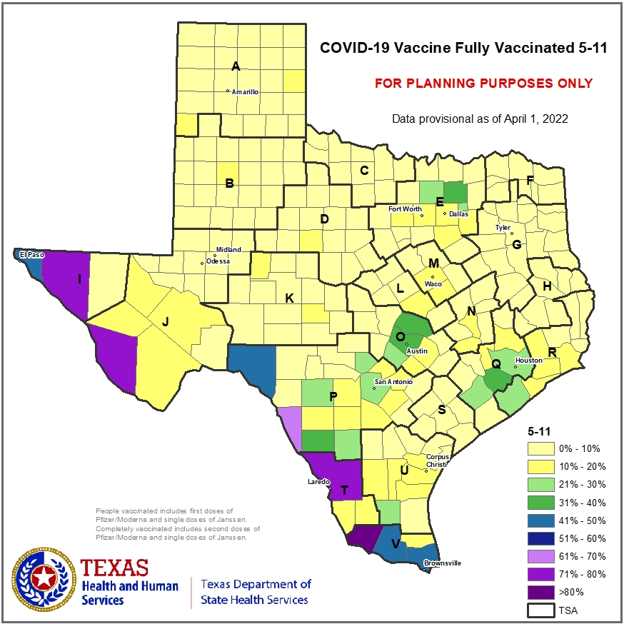
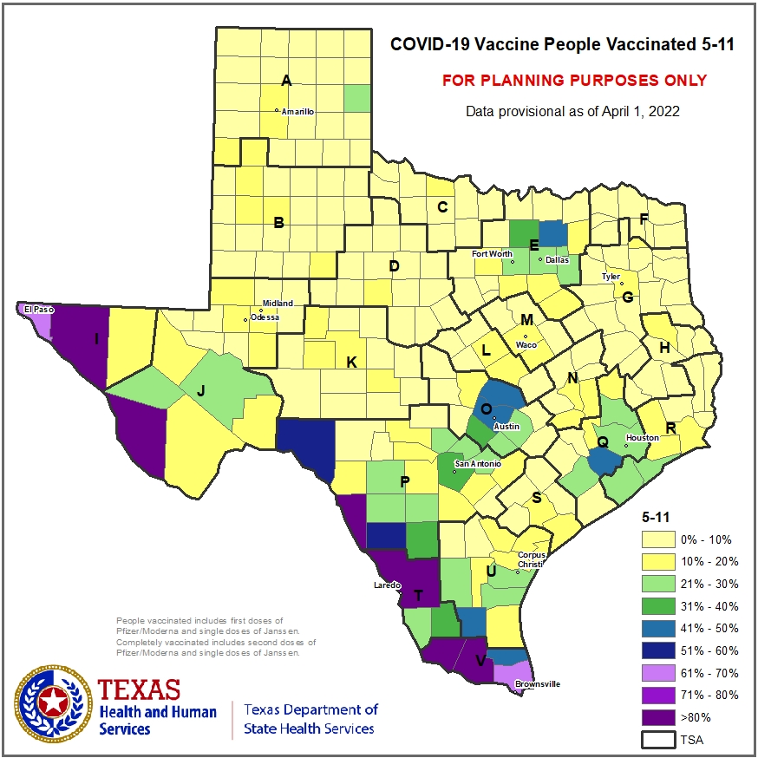
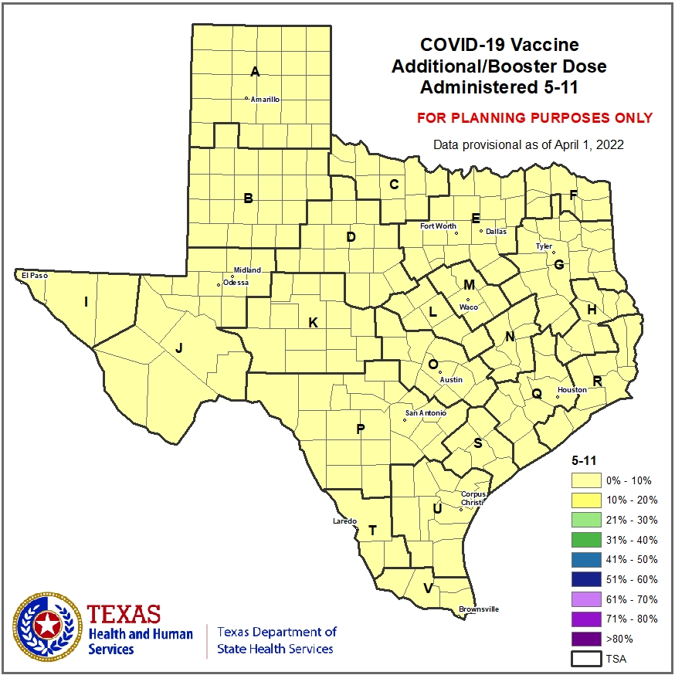

Slide 19
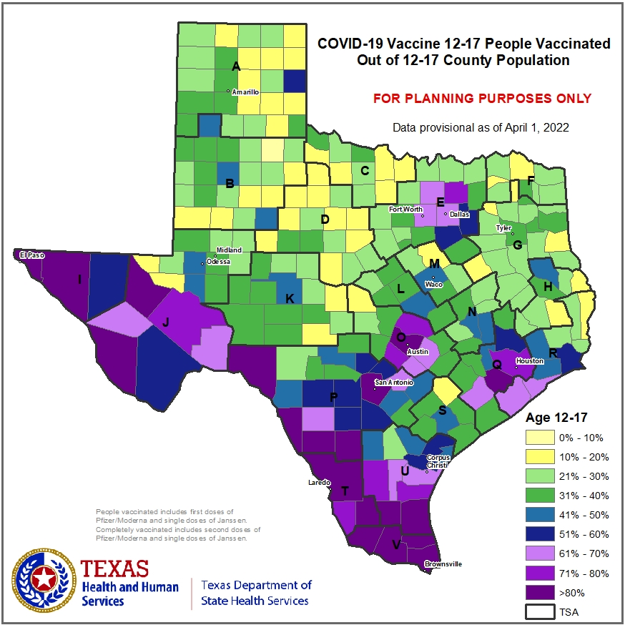
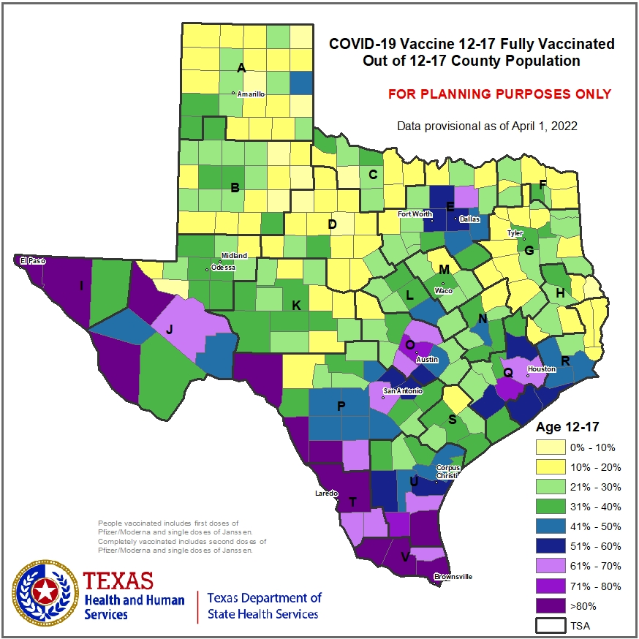
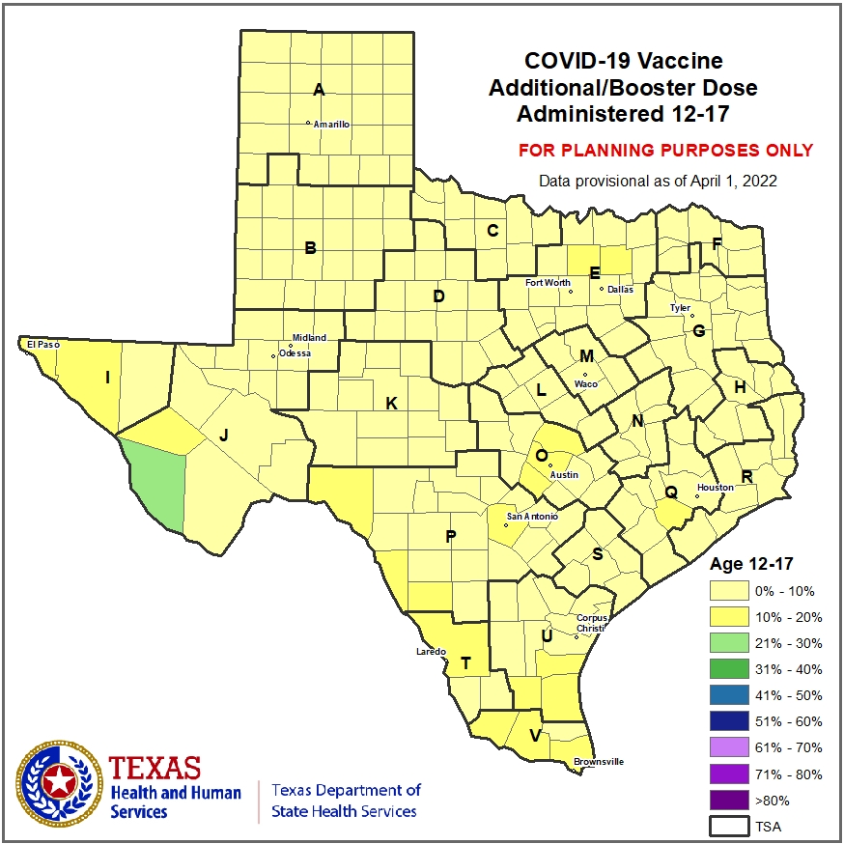

Slide 20
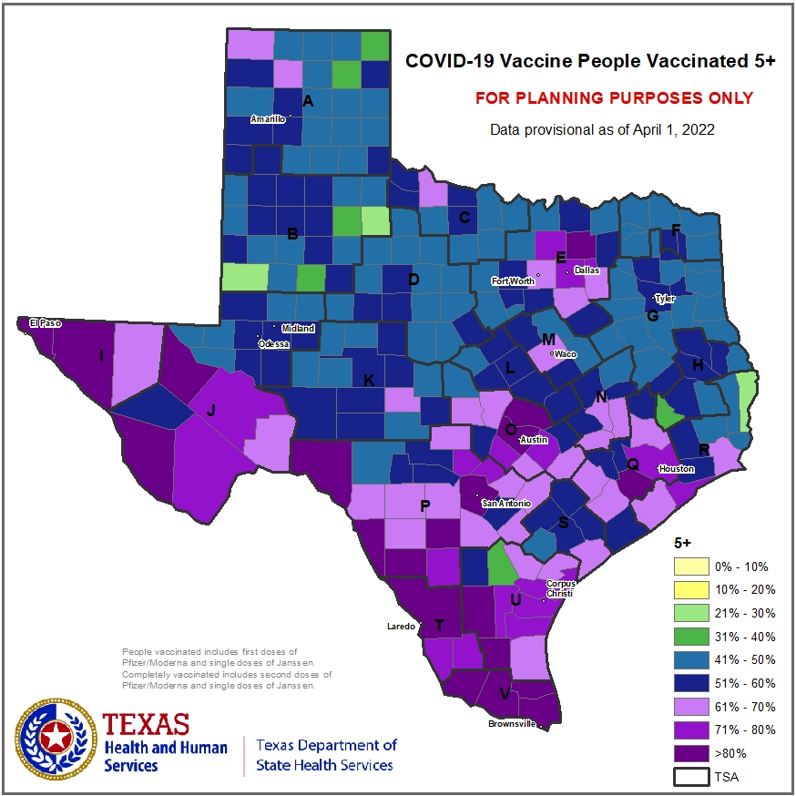
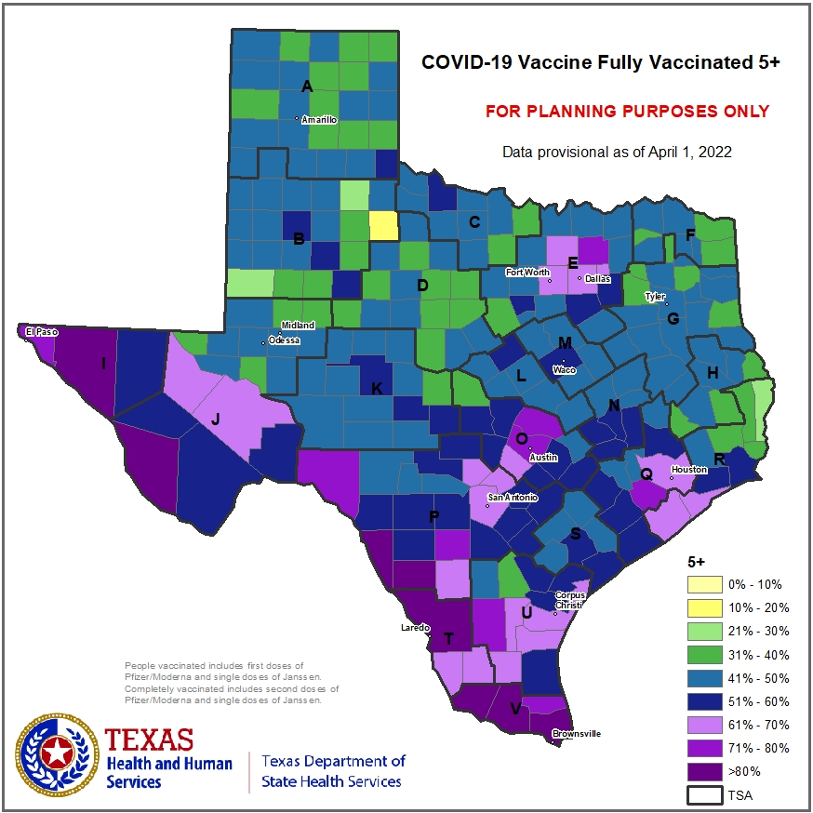
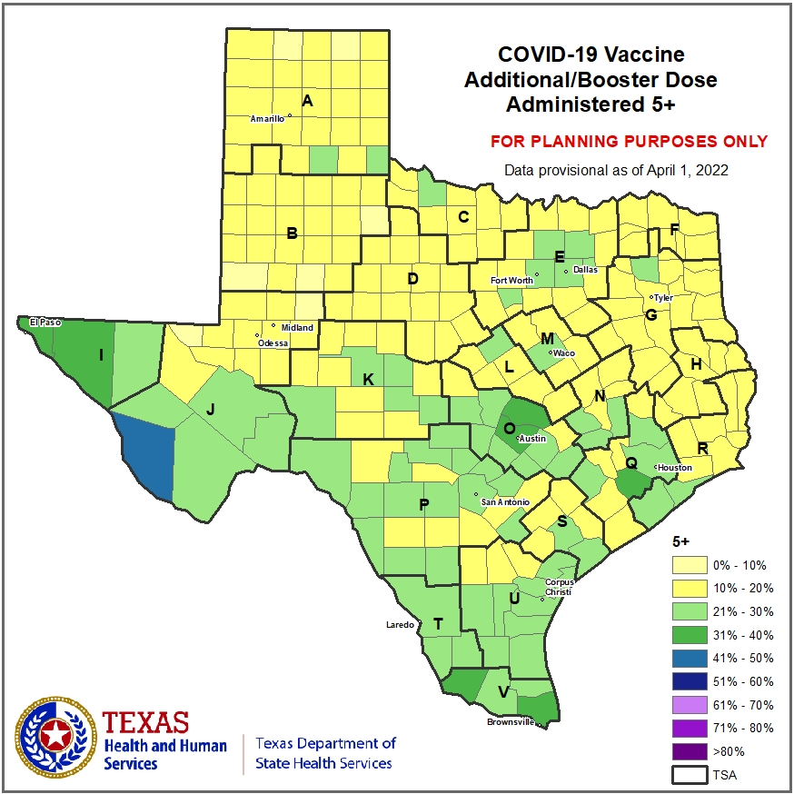

Slide 21
DISCLAIMER
The information presented today is based on CDC’s recent guidance and MAY change.
April 13, 2022

