Slide 1

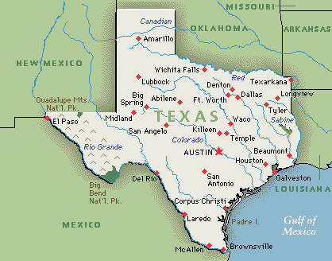
Preventable Adverse Event Reporting
Vickie Gillespie, PAE Clinical Specialist
04/28/15
Notes:
Welcome to Preventable Adverse Event (PAE) Reporting. My name is Vickie Gillespie. I am the PAE Clinical Specialist at the Texas Department of State Health Services.

Slide 2
Preventable Adverse Event (PAE) Reporting in Texas
Objectives:
  Review the background of Preventable Adverse Event reporting nationwide and in Texas.
  Summarize the reporting program.
  Share Texas reported events to date.
Adverse Event: An event that results in unintended harm to the patient by an act of commission or omission rather than by the underlying disease or condition of the patient.
Notes:
In this presentation I will review the background of Preventable Adverse Event reporting across the nation as well as what we are doing here in Texas, beginning January 1, 2015. In so doing, I will share the legislative mandate this program.
Additionally, I will tell you specifics about what is reportable, share the reporting process and explain what the public reporting will be like.
Finally, I will share what events have been reported year to date in Texas.
So let’s begin.

Slide 3

Why Report?
1999 Institute of Medicine (IOM)*
  Estimated 98,000 deaths/year
  Most were systemic errors
  Called for a nationwide, mandatory reporting system
2013 John T. James, PhD**
  2008-2011 four studies estimated a lower limit of 210,000 deaths/year
  Newest estimate is 440,000 deaths/year
  Serious harm 10-20 times higher than lethal harm (2-4 Million serious harm events/year)
*To err is human: building a safer health system. Kohn LT, Corrigan JM, Donaldson MS (Institute of Medicine). Washington, DC:National Academy Press, 2000.
**A New, Evidence-based Estimate of Patient Harms Associated with Hospital Care, James, John T. PhD, Journal of Patient Safety: September 2013 - Volume 9 - Issue 3 - p 122-128
Notes:
You may wonder, why should we report Preventable Adverse Events?
You are probably familiar with the 1999 Institute of Medicine (IOM) report “To err is human: building a safer health system” that estimated 98,000 deaths in the US every year are caused by medical errors. Most of these were felt to be systemic errors, but nevertheless, the report called for a mandatory, nationwide reporting system—to get a handle on this hugely significant problem.
In researching for more current estimations of death rates due to medical errors, or adverse events in health care, I found this article by Dr. John James which was published in 2013. Dr. James reviewed 4 separate studies that were completed from 2008 through 2011. These studies were done by CMS and looked at Medicare populations. The findings were based primarily on evidence in hospital medical records found by the use of the GTT (Global Trigger Tool). Dr. James estimated 210,000 deaths per year, and that was on the lower limit. He went on to estimate there would be 440,000 deaths per year in 2013, and that the rate for serious harm would be 10-20 times higher than that for lethal harm. That is roughly 1/6 of all deaths that occur—a leading cause of death following Cancer and Heart Disease—and only about 14% of these are captured by a reporting system.
Needless to say, we need to take close stock of these numbers.

Slide 4

Scope of the Problem
Falls—
  700,000-1,000,000 falls annually¹
  Leading cause injury-related death 65 & older
  $30 billion by 2020^{2,3}
Pressure Ulcers—
  257,412 Medicare patients 2007¹
  60,000 patients die annually from HA PUs
  Average charge of $43,180⁴
Medication Errors—
  1000/day in hospitalized pts⁵
  15/100 admissions—75% preventable⁶
HAIs—
  2 Million annually in US⁷ (200,000 in Texas⁸)
  ~ 90,000 deaths (8-9000 Texas deaths)
  ~ $5 billion - $ 31.5 billion² healthcare costs
Notes:
^{1 AHRQ}
²Centers for Disease Control and Prevention
³UlrichR, Zimring C
⁴Armstrong DG, Ayello EA, Capitulo KL, et al.
⁵How Not to Get Sick(er) in the Hospital, Consumer Reports, February 2015
⁶Massachusetts study reported by Dr. David Classen in a webinar put on by RTI International for the Office of the National Coordinator for Health Information Technology (ONC), Health IT Safety Center . He is the Intermountain Healthcare’s clinical Quality Committee for Drug Use and Evaluation Chair.
⁷NQF’s National Voluntary Consensus Standards for the Reporting of HAI Data
⁸Magill, S., Edwards, J., Bamberg, W., Beldavs, Z., Dumyati, G., Kainer, M., . . . Fridkin, S. (2014). Multistate point-prevalence survey of health care-associated infections. N Engl J Med, 1198-208. The Centers for Disease Control and Prevention. (2009, December 29). Template Document for Texas Healthcare-Associated Infections (HAI) Plan. Retrieved from http://www.cdc.gov/HAI/pdfs/stateplans/tx.pdf
Additional info published on the JCAHO website
JCAHO 700,000-1M falls /year; 11,000 fatal falls year.
Cost of fall with injury $14,056
Surgical site infections (SSIs) are one type of HAI. They occur in more than
500,000 patients annually (Meeks, et al., 2011).

Slide 5
World Health Organization
Healthcare prone to accidents—
  Greatest contributor is human error
  Most human errors induced by system failures
    Reason’s Swiss Cheese Model
One solution is reporting—
  By doctor, nurse or other provider within an organization
  By the organization to a broader audience
Effective reporting—
  Cornerstone of safe practice
  Measure of progress toward a safety culture
Draft Guidelines for Adverse Event Reporting and Learning Systems, World Alliance for Patient Safety, World Health Organization, 2005
Notes:
So, in the years following the IOM’s report, the World Health Organization put forth draft guidelines for reporting of these events. Their 2005 publication said,
“Healthcare is prone to accidents. I think we all are aware of that with complexity of our procedures and equipment, multi-disciplines involved, and acuity of our patients.
Most of these accidents are caused by, again, system failures, but the greatest contributor to system failures being human error.

Slide 6
Reason’s Swiss Cheese Model
Organization’s layers of protection/defenses against hazards
Holes represent weaknesses/gaps
Hazards Med Adm
Organizational influences
Low focus on safety
Unsafe supervision
Less time for orientation
Losses Med Error
Precondition for unsafe act
Look alike drugs on same shelf
Unsafe act
Administering incorrect drug
Source: Reason J. Human error: models and management. BMJ. 2000 Mar 18;320(7237): 768-70.
Notes:
James Reason
James Reason hypothesizes that most accidents can be traced to one or more of four levels of failure: Organizational influences, unsafe supervision, preconditions for unsafe acts, and the unsafe acts themselves. In this model, an organization's defenses against failure are modelled as a series of barriers, with individual weaknesses in individual parts of the system, and are continually varying in size and position. The system as a whole produces failures when all individual barrier weaknesses align, permitting "a trajectory of accident opportunity", so that a hazard passes through all of the holes in all of the defenses, leading to a failure.^{[1][2]} The model includes, in the causal sequence of human failures that leads to an accident or an error, both active failures and latent failures. The former concept of active failures encompasses the unsafe acts that can be directly linked to an accident, such as (in the case of aircraft accidents) pilot errors. The latter concept of latent failures is particularly useful in the process of aircraft accident investigation, since it encourages the study of contributory factors in the system that may have lain dormant for a long time (days, weeks, or months) until they finally contributed to the accident. Latent failures span the first three levels of failure in Reason's model. Preconditions for unsafe acts include fatigued air crew or improper communications practices. Unsafe supervision encompasses such things as, for example, two inexperienced pilots being paired together and sent on a flight into known adverse weather at night. Organizational influences encompass such things as reduction in expenditure on pilot training in times of financial austerity.^{[2][3]}
For example, a latent failure could be the similar packaging of two different prescription drugs that are then stored close to each other in a pharmacy. Such a failure would be a contributory factor in the administration of the wrong drug to a patient. Such research has led to the realization that medical error can be the result of "system flaws, not character flaws", and that individual greed, ignorance, malice, or l
laziness are not the only causes of error.
Another example: Safe Traffic Conditions/Safe Vehicle/Safe Road Conditions/Driver Awareness

Slide 7
World Health Organization
Healthcare prone to accidents—
  Greatest contributor is human error
  Most human errors induced by system failures
One solution is reporting—
  By doctor, nurse or other provider within an organization
  By the organization to a broader audience
Effective reporting—
  Cornerstone of safe practice
  Measure of progress toward a safety culture
Draft Guidelines for Adverse Event Reporting and Learning Systems, World Alliance for Patient Safety, World Health Organization, 2005
Notes:
They went on to say that one solution is to simply “report”—by doctor, nurse or other healthcare provider both within our organizations (internally) but also outside of our individual facilities to a broader audience.
This then they felt would promote effective reporting and be a cornerstone of safe practice…and progress toward a safety culture.

Slide 8

Reasons for PAE Reporting
Establish Standards
Transparency
Systemic Learning
Consumer’s right to know
Evidence-based Practices
Increase Patient Safety
Notes:
8
In summary, I see a number of reasons that reporting your adverse events is important.
Starting with the Consumer’s right to know and be informed, give informed consent etc, which has been around for quite awhile.
And we seen a strong push for transparency in all aspects of our lives, and now in Healthcare and for these events. We are trying to build on the principles of transparency and consumer choice to create incentives and motivate healthcare organizations and providers to provide better, more efficient care.
Then to establish standards. There is widespread variation in definitions and reporting systems and we need standardization so that we can aggregate data and learn from it. This will lead to systemic learning, both internally in your organizations as well as across the US. Honest, transparent reporting of falls must be encouraged to analyze conditions associated with falls, identify patterns of risk, and develop improved care processes.
We know how important evidence-based practice is and there are already some of those published for patient safety, such as surgical checklists. But we need to have more evidence-based practices developed and shared.
This of course will lead us to an increase in patient safety, and a decrease in patient grief and suffering.

Slide 9

AHRQ 2014 Healthcare
Quality and Disparities Report
Between 2010 and 2013:
  Patient Safety improved
  17% reduction in rates of hospital-acquired conditions.
  Half of Patient Safety measures improved
  1.3 million fewer harms to patients
  50,000 lives saved (est)
  $12 billion in cost savings (est)
Notes:
2014 NATIONAL HEALTHCARE
QUALITY AND DISPARITIES REPORT
U.S. DEPARTMENT OF
HEALTH AND HUMAN SERVICES
Agency for Healthcare Research and Quality
540 Gaither Road
Rockville, MD 20850
AHRQ Publication No. 15-0007
April 2015
www.ahrq.gov/research/findings/nhqrdr/index.html
Trends
• From 2010 to 2013, the overall rate of hospital-acquired conditions declined from 145 to 121
per 1,000 hospital discharges.
• This decline is estimated to correspond to 1.3 million fewer hospital-acquired conditions,
50,000 fewer inpatient deaths, and $12 billion savings in health care costs.3
• Large declines were observed in rates of adverse drug events, healthcare-associated
infections, and pressure ulcers.
• About half of all Patient Safety measures tracked in the QDR improved.
• One measure, admissions with central line-associated bloodstream infections, improved
quickly, at an average annual rate of change above 10% per year.
• One measure, postoperative physiologic and metabolic derangements during elective-surgery
admissions, got worse over time.
Distribution of hospital-acquired conditions based on national rates per 1,000 hospital adult
discharges, 2010-2013
Source: Agency for Healthcare Research and Quality, Medicare Patient Safety Monitoring System, 2010-2013;
Centers for Disease Control and Prevention, National Healthcare Safety Network, 2010-2013; and Agency for
Healthcare Research and Quality, Healthcare Cost and Utilization Project, Nationwide Inpatient Sample, 2010-2012.

Slide 10
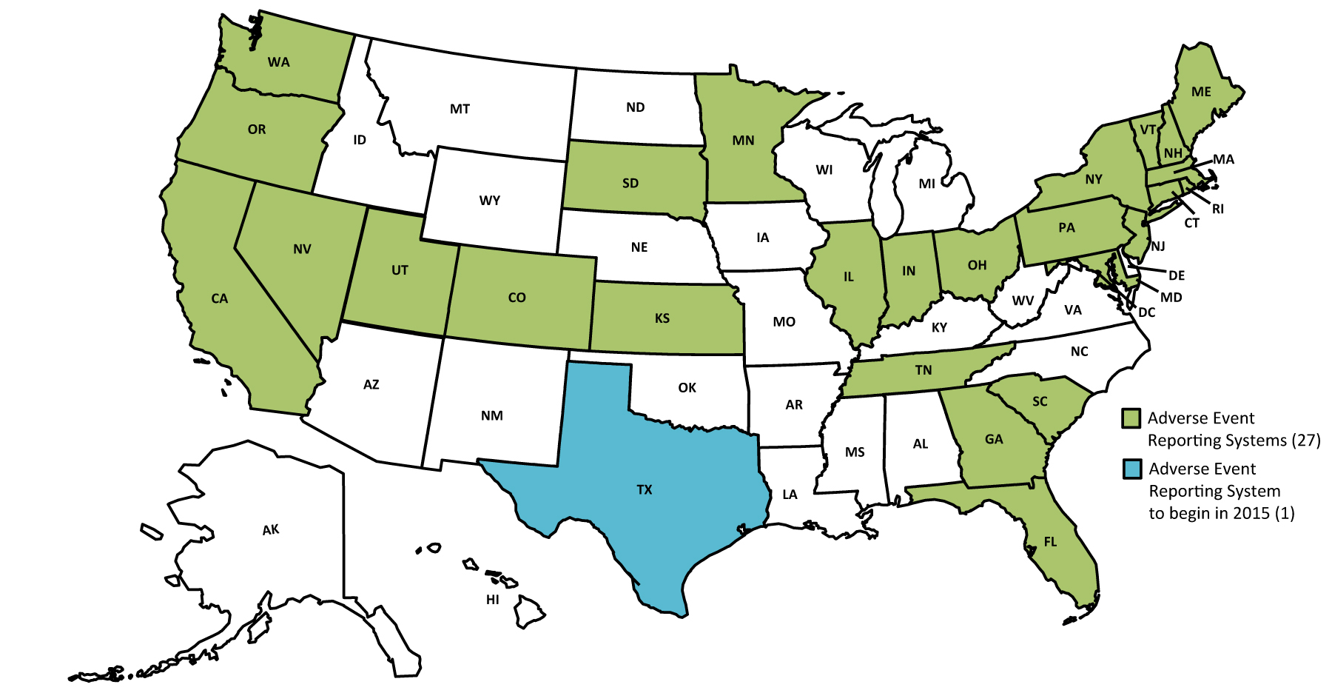
Public Reporting of Adverse Events
2014 Guide to State Adverse Event Reporting Systems
National Academy for State Health Policy

Slide 11

PAE Reporting in Texas
80th Legislative Session 2007 (SB 288)
  Chapter 98 Health and Safety Code
  HAI Reporting, Advisory Panel
81st Legislative Session 2009 (SB 203)
  PAE added and required:
  *Healthcare facilities to report certain preventable adverse events to the DSHS,
AND
  *DSHS to make this data
  available to the public
  by facility, by type, and by number.
Notes:
What is the history of PAE reporting in Texas?
Chapter 98 , Reporting of Health Care-Associated Infections and Preventable Adverse Events was adopted by the 80th Legislative Session in 2007 and had specific language regarding reporting HAIs or health care-acquired infections, and set forth requirements for an Advisory Panel.
In 2009, the PAE description and required reporting was added including the mandate for public reporting of the data.

Slide 12

Who Must Report?
General Hospitals licensed under Chapter 241 or a hospital that provides surgeries or obstetrical services and is maintained or operated by this State.
  All General Hospitals provide OB and/or Surgery.
  Comprehensive Medical Rehabilitation Hospitals do not have to report.
  LTAC’s must report if they are licensed as a General Hospital (provide OB and/or Surgery).
  It does not include a LTAC licensed as a Special Hospital.
Ambulatory Surgery Centers licensed under Chapter 243.
Notes:
So, who must report?
All general hospitals that are licensed under Chapter 241. General hospitals provide OB and/or Surgery. Also, any state operated hospitals that provide OB or Surgery are required to report.
Comprehensive Medical Rehab Hospitals are waived in this legislation and do not have to report.
An LTAC would have to report if it is licensed as a General hospital—which means it does surgery.
If the LTAC is licensed as a Special Hospital it does not have to report.
Any hospital licensed as a Special hospital does not have to report.
Federal VA’s do not have to report.
Also--
All Ambulatory Surgery Centers that are licensed under Chapter 243 are required to report.

Slide 13
What is Reported?
Only ACTUAL events are reported:
  Category of Event
  Type of Event
  Date of Event
  MR/Patient ID#,
  Level of Harm
Details of the event and root cause analysis are NOT required—but may be submitted.

Slide 14
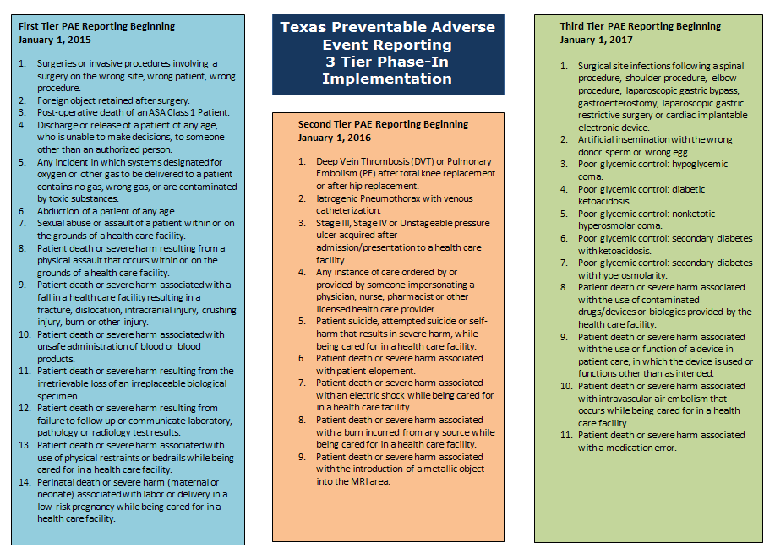
Notes:
This is the current PAE brochure produced by DSHS. Available by contacting paetexas@dshs.state.tx.us

Slide 15
First Tier PAE Reporting
January 1, 2015
SURGICAL OR INVASIVE PROCEDURE EVENTS
Surgeries or invasive procedures involving a surgery on the wrong site, wrong patient, wrong procedure.
Foreign object retained after surgery.
Post-operative death of an ASA Class 1 Patient.
PATIENT PROTECTION EVENTS
Discharge or release of a patient of any age, who is unable to make decisions, to someone other than an authorized person.
Notes:
Here is a listing of the reportable PAEs that start in January 2015. These are divided by category. These categories are the same categories that are used by the NQF in the list of SREs.
You will need to know these categories when you go to enter your data.
You can find a document that displays the PAEs by category on our website at www.paetexas.org on the Resources page.

Slide 16
First Tier PAE Reporting
January 1, 2015
ENVIRONMENTAL EVENTS
Any incident in which systems designated for oxygen or other gas to be delivered to a patient contains no gas, wrong gas, or are contaminated by toxic substances.
Patient death or severe harm associated with use of physical restraints or bedrails while being cared for in a health care facility.
POTENTIAL CRIMINAL EVENTS
Abduction of a patient of any age.
Sexual abuse or assault of a patient within or on the grounds of a health care facility.
Patient death or severe harm resulting from a physical assault that occurs within or on the grounds of a health care facility.

Slide 17
First Tier PAE Reporting
January 1, 2015
Patient death or severe harm associated with unsafe administration of blood or blood products.
Patient death or severe harm associated with a fall in a health care facility resulting in a fracture, dislocation, intracranial injury, crushing injury, burn or other injury.
Patient death or severe harm resulting from the irretrievable loss of an irreplaceable biological specimen.
Perinatal death or severe harm (maternal or neonatal) associated with labor or delivery in a low-risk pregnancy while being cared for in a health care facility.
Patient death or severe harm resulting from failure to follow up or communicate laboratory, pathology or radiology test results.
CARE MANAGEMENT EVENTS

Slide 18


PAE Reporting Schematic
PAE Event Report
Texas Healthcare
- Safety Network -
Email Reminders
Access Facility Report
Facilities report directly into TxHSN via TDSHS website portal. Facility-specific reports are then generated.
Notes:
18
This is how the PAEs are reported into TxHSN and processed by TxHSN.

Slide 19


HAI Reporting Schematic
HAI data
HAI Data
DSHS exports HAI data from NHSN and stores it in TxHSN.
Facility-specific reports are then generated.
Access Facility Report
Texas Healthcare
- Safety Network -
Email reminders
Data export
Notes:
19
This is how TxHSN obtains and processes HAI reports.

Slide 20
What Will be Shared with the Public?
The PAE results will be included in the current HAI public report--link on www.HAITexas.org.
PAEs will be reported by facility, by name and by number.
Example:
Type of Event | Total Number
Patient death or severe harm associated with unsafe administration of blood or blood products | 1
Foreign object retained after surgery | 1
Notes:
The PAE data report for consumers will appear on the bottom of the current HAI report that is posted to our website. These reports are by facility and will show the type of event (or category) and the specific PAE with the number that occurred for a specific time period. This slide shows an example of that.

Slide 21
53 PAEs Reported YTD
Type of Event | Total Number
Patient Death or Severe Harm Associated with a Fall Resulting in a Fracture | 19
Foreign Object Retained After Surgery | 9
Patient Death or Severe Harm Associated with a Fall Resulting in an Intracranial Injury | 7
Wrong Site Surgery | 7
Wrong Surgery/Procedure | 6
Patient Death or Severe Harm Resulting from Failure to Follow Up or Communicate Laboratory, Pathology or Radiology Test Results | 1
Perinatal Death or Severe Harm (maternal or neonate) Associated with Labor or Delivery in a Low-Risk Pregnancy while being cared for in a health care facility | 1
Patient Death or Severe Harm Associated with a Fall Resulting in Other Injury | 1
Patient Death or Severe Harm Associated with the Use of Physical Restraints or Bedrails while being cared for in a health care facility | 1
Intra-operative or Immediately Post-operative Death of an ASA Class 1 Patient | 1
TxHSN 01/01/2015-04/27/15 27 Hospitals 9 ASCs
Notes:
These are tentative numbers of the PAEs reported YTD.

Slide 22
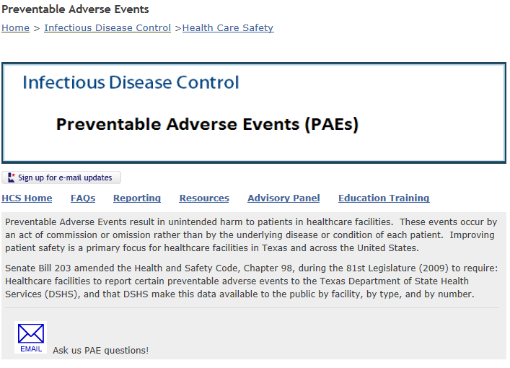
www.PAETexas.org
PAETexas@dshs.state.tx.us
Notes:
This is our PAE web page. Sign up for Email Updates by clicking on the icon in the center of the page above the menu page tabs.
If you have questions you can click on the letter at the bottom of the page.

Slide 23

Questions?
Thank you!
Questions?
Thank you!
Notes:
Please do not hesitate to send questions regarding this very important process to improve patient safety in Texas. Thank you.

