Slide 1
ImmTrac2 Data Accessibility
Kevin Allen, IIS Director
Texas Immunization Registry

Slide 2
Agenda
Immunization Reporting
Disaster & Emergencies Reporting
Registry Confidentiality
Release of Data
Post COVID-19 Event

Slide 3
Immunization Reporting
Consent for under 18 years of age is required to be obtained only one time:
parent
guardian
Immunization info will remain in the registry:
until 18 years of age
consent is withdrawn
deceased

Slide 4
Immunization Reporting
Adult consent must be submitted after turning 18:
individual
legally authorized representative
Immunization records are retained for individuals 18 years to 26 years of age that have “aged out”
Records not accessible to users
No consent by 26th birthday – records are purged

Slide 5
Immunization Reporting
Providers and health plans:
Shall report to the registry for individuals <18 years
DSHS verifies consent before including in registry
DSHS may not retain any information on an individual for whom consent cannot be verified

Slide 6
Disaster & Emergency Reporting
DSHS shall maintain a registry of persons who receive an immunization, antiviral, and other medication (AIM) administered in preparation for OR in response to:
potential disaster
public health emergency
terrorist attack
hostile military or paramilitary action
extraordinary law enforcement emergency

Slide 7
Disaster & Emergency Reporting
Providers required to provide the data to DSHS
5-year retention of data after the event end date for unconsented individuals
Unless disaster consent is provided, all disaster-related data will be purged
Lifetime retention of data for Disaster-consented individuals

Slide 8
Registry Confidentiality
DSHS may not release registry info to any individual or entity without the consent of the individual
A person required to report info for registry purposes or authorized to receive info from the registry may not disclose individually identifiable info to any other person without written or electronic consent of the individual or their legally authorized rep

Slide 9
Registry Confidentiality
Registry info is NOT:
subject to discovery, subpoena, or other means of legal compulsion for release to any person or entity; or
admissible in any civil, administrative, or criminal proceeding

Slide 10
Release of Data
Data Release to Public and CDC
Non-identifying summary statistics related to the registry that do not individually identify a person
Data Release to Local Jurisdictions
Weekly COVID line-level data for individuals via Globalscape
Some jurisdictions also receive adjoining county line-level data as directed by HSC 1001.089

Slide 11
Release of Data

Slide 12
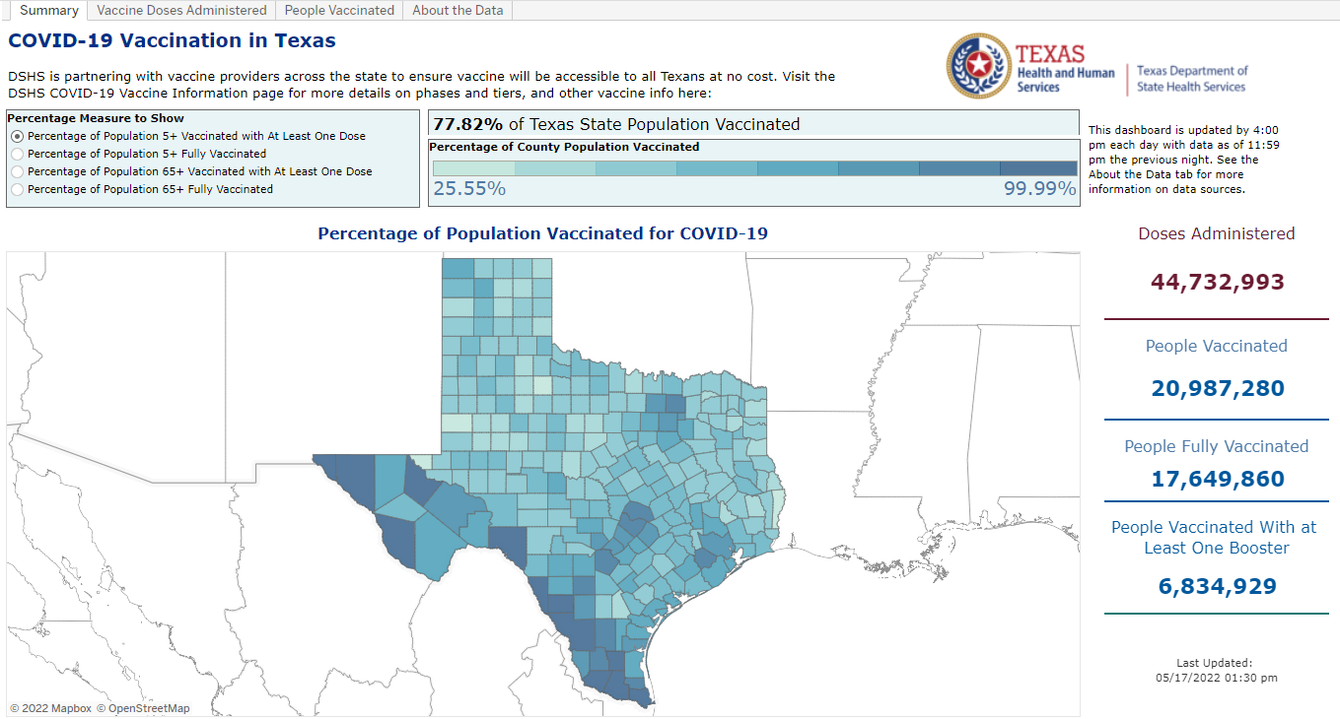
Release of Data
Public Facing COVID-19 Dashboard

Slide 13
Release of Data
COVID Data Charts/Graphs

Slide 14
Release of Data
 | Population Estimates | People Vaccinated | Fully Vaccinated | Percent of Population with at least One Additional/Booster Dose
Texas Total | 28,995,881 | 20,876,360 | 17,562,770 | 6,719,006
 |  | 72% | 61% | 23%
5-11 years | 2,898,962 | 1,050,158 | 714,461 | 2,116
 |  | 36% | 25% | 0%
5 years and older | 26,967,586 | 20,870,602 | 17,561,356 | 6,718,957
 |  | 77% | 65% | 25%
12 years and older | 24,068,624 | 19,820,444 | 16,846,895 | 6,716,841
 |  | 82% | 70% | 28%
18 years and older | 21,596,071 | 17,980,155 | 15,389,660 | 6,472,033
 |  | 83% | 71% | 30%
65 years and older | 3,734,229 | 3,572,108 | 3,178,337 | 2,044,532
 |  | 96% | 85% | 55%
COVID Data Charts/Graphs
People Vaccinated includes first doses of Moderna and Pfizer and single doses of Janssen.
Fully Vaccinated includes second doses of Moderna and Pfizer and single doses of Janssen.
Population with at least one additional/booster dose is the first dose after primary series completion if dose administered is after 8/13/21.
Data as of 4/27/2022

Slide 15
Release of Data
COVID Data Charts/Graphs

Slide 16
Post COVID-19 Event
Declared End Date of an Event
Legal counsel reviewing statute
Some/All disaster event data dissemination may discontinue
New individuals receiving COVID-19 immunization that are unconsented will not be stored in the registry
Disaster-related individuals receiving additional COVID doses will not be stored

Slide 17
Thank you
Kevin Allen, IIS Director
Texas Immunization Registry

